Slide 1


Accelerated Reader: A Guide for Parents

Slide 2
Accelerated Reader: A Guide for Parents
At GJA, all pupils use the Accelerated Reader programme, which is designed to do the following things:
Find books that are the right ability for your child
Encourage your child to read more
Improve your child’s reading ability.

Slide 3

How it works…
At the start of the year every pupil took a Star Reader Test, which is a computer-based test that measures a student’s reading ability through a series of 34 questions.
Every test for every pupil is different, and the computer selects different questions for each child dependent on how well they answer the previous questions. Essentially, the computer adapts the test to suit your son or daughter.
Once the student has completed the test, they are then given a ZPD score by their teacher.

Slide 4
How STAR tests work
The pupil must take their time. It is recommended that each child should spend at least 20 minutes on their tests. Students are used to working quickly in timed conditions, but during a STAR test it is about concentration, focus and careful reading.
Pupils should not guess answers to questions. Instead, they should wait for the question to time out. This is to ensure the computer is not given a false impression of the child’s reading ability.
Tests are done in exam conditions without any help from other pupils or the teacher.

Slide 5
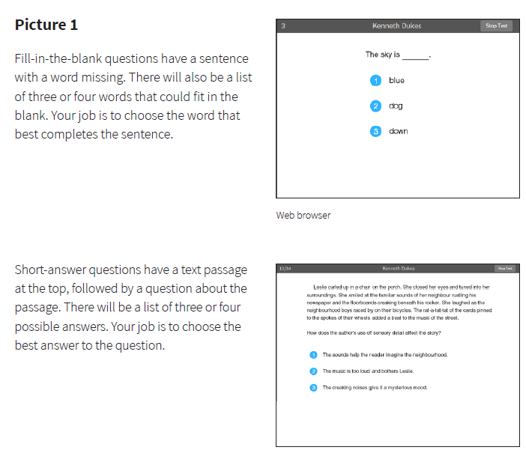

Slide 6

A ZPD score is given to your child after completing the STAR test
3.2 – 4.6
ZPD is two numbers that the pupil uses to choose their next reading book.
The lowest number is the lowest level of book the pupil should be choosing.
The highest number is the highest level of book the student should be choosing.
A new STAR test takes place every half term, so students can see improvements in their reading ability, but also choose more challenging books.
Lowest number
Highest number

Slide 7
AR Quizzes
A quiz is different to a STAR test because students only take a quiz after they have finished a book.
There are usually between 5-10 questions on the book that has been read. At the end of the quiz the pupils are given a percentage to show them how well they have done.
There are some important rules for taking quizzes:
The book the child is quizzed on must be a book they have read in the last two days. AR is not a memory test but rather measuring reading ability.
A student cannot take a quiz until they have read the entire text.
Quizzes must be done individually, not with anyone’s help.

Slide 8
“How much should my child read each day?”
According to Renaissance Learning’s research, children who read at least 20 minutes a day with a 90% comprehension rate on AR quizzes see the greatest gains in progress.
Therefore, your child should have at least 20 minutes set aside for reading during day.
Teachers expect children to be reading for 20 minutes as daily homework. Parents should monitor this and sign their reading record.

Slide 9
“How can I help?”
As with anything, performance improves with practice.
Encourage your child to read at home.
Create a culture of reading in your household by reading with your child, starting a home library, visiting your local library, charity shop or bookshop on a regular basis and by letting your child see you reading.
When reading with your child stop and ask questions to be sure your child comprehends what they have read and in general make a habit of discussing books that each of you has read.

Slide 10
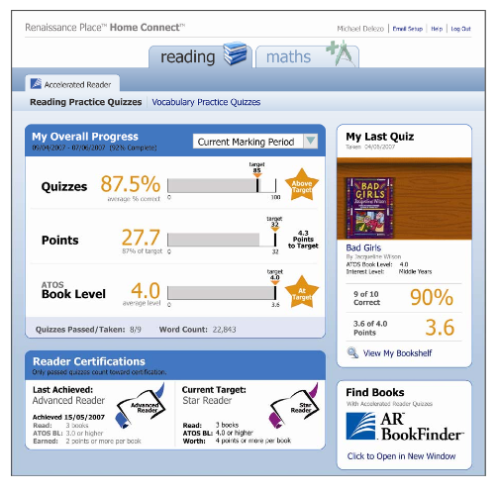
How will I know how my child is doing?
You can access your child’s AR information in Renaissance Place Home Connect from any web-enabled computer.
Once in the programme, you can view your child’s progress towards targets, points and books read.
You can also access AR BookFinder to search for titles of interest.
You can only access information about your own child.

Slide 11
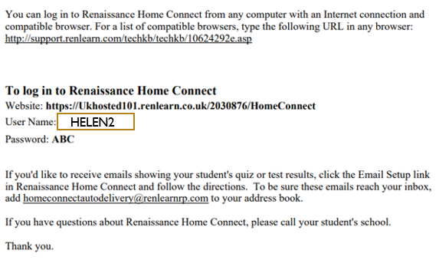
How to use Home Connect
Copy the link to get to the Home Connect Website.
Enter your login details.

Slide 12
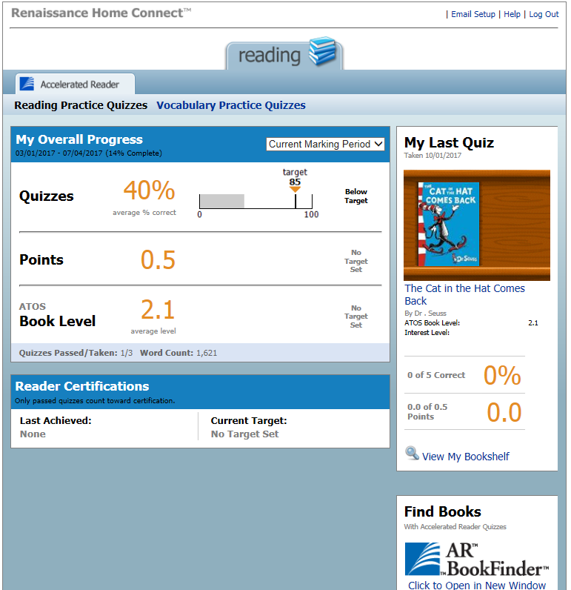
Average quiz score
Points earned
Average book level.
Last book read and quizzed on. Include % correct and points earned from book.

Slide 13
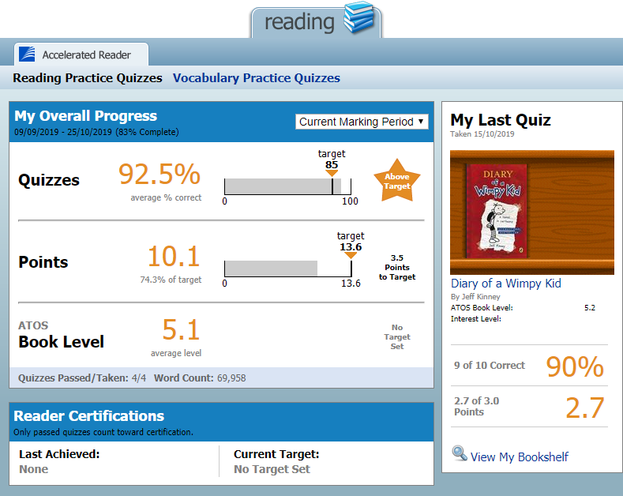
Click here to see what your child has been reading.

Slide 14
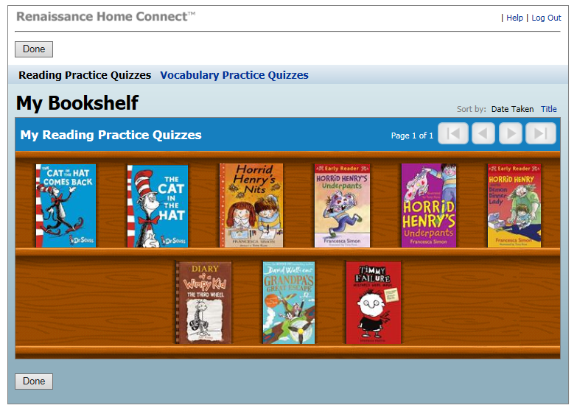
Your child’s bookshelf
You can click on each book to see how well your child achieved.

Slide 15
Can a child who is not a strong reader still use Accelerated Reader?
Accelerated Reader helps all children become better readers from pupil, regardless of initial ability.
When children read books at their appropriate level, they experience success.
Furthermore, teachers work with children to set appropriate targets based on each child’s reading level.
Key questions to help improve your child’s reading:
Does it look right?
Does it sound right?
Does it make sense?

Slide 16
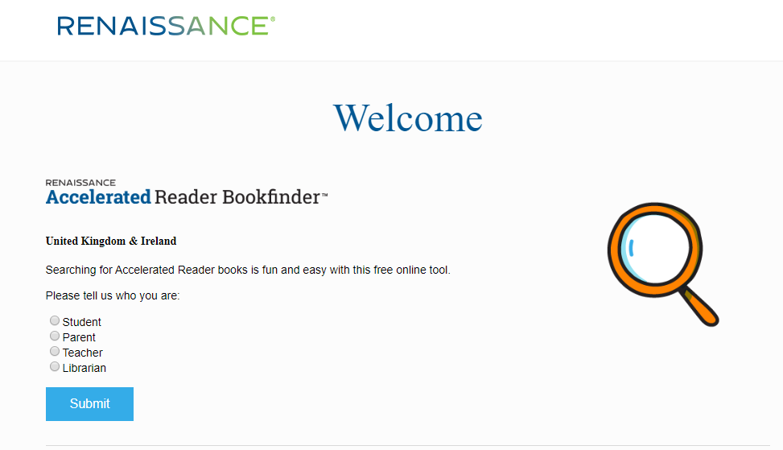
Book Finder
In google, search for ‘Accelerated Reader Book Finder’
Click parent

Slide 17
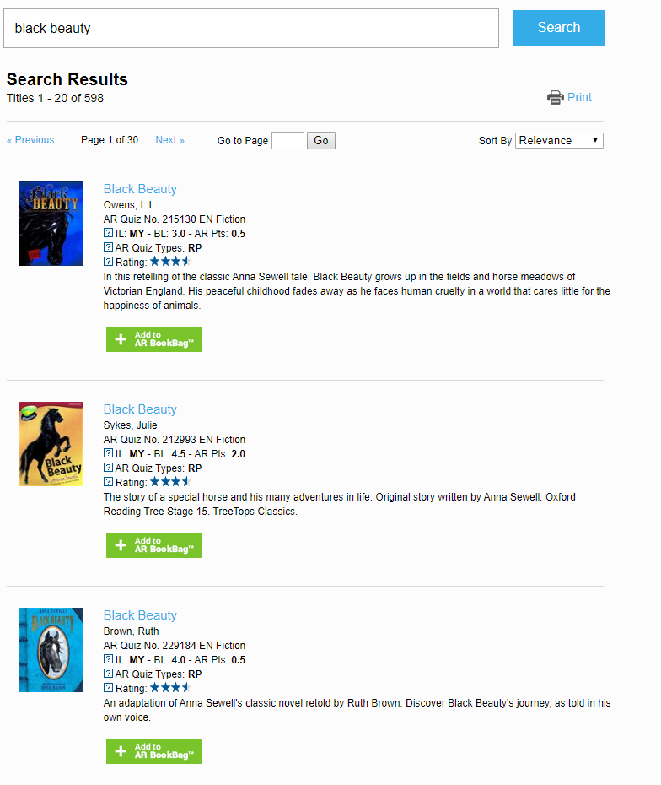
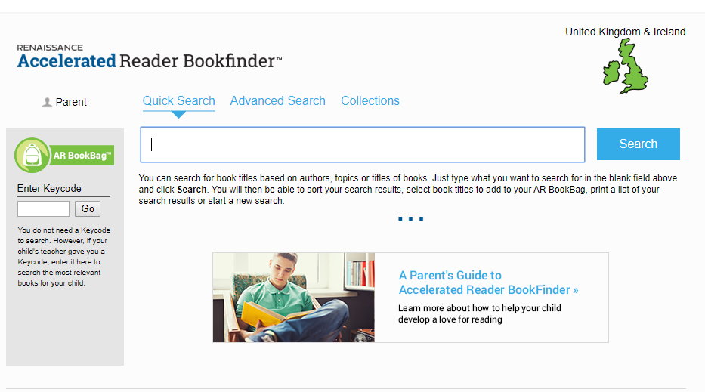
Type in the title of your home book to find out what level it is.

Slide 18
Progress in Reading
If a child can read 96% or more of a book correctly = Easy for them
If a child can read 90%-95% of a book correctly = Instructional Level (This is ideal and where they learn and improve.)
If a child reads 89% or less of a book correctly = Hard
To make progress in reading we need our pupils to be passing their quizzes at 85%+
By reading with your child you can help them to achieve this target.

Slide 19
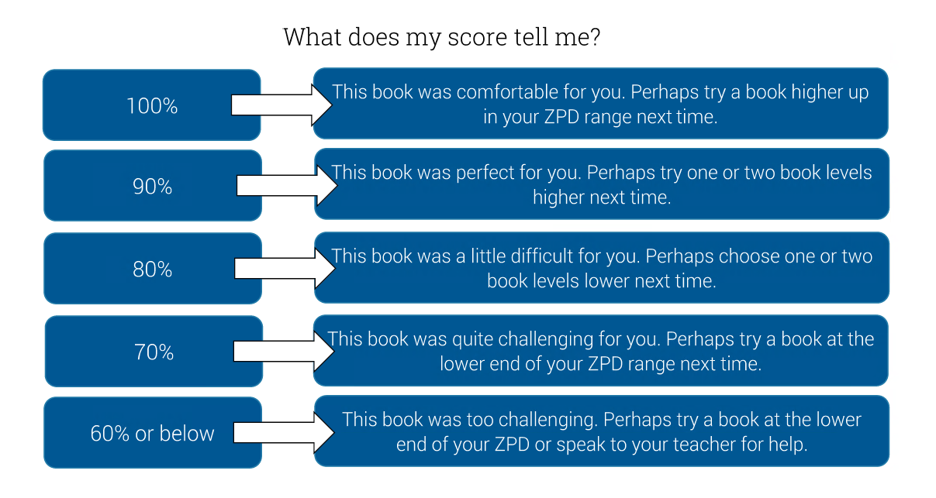
When to move up a book level

