Slide 1
VFS champions

Slide 2
Your latest results: “Should the UK open new oil fields?”
VFS champions
“I think yes, because I know my parents will want to pay less for energy so they can spend money on more necessities.”
Homerswood Primary and Nursery School
“Yes, because it will boost the economy and lower taxes and it will also bring new job opportunities.”
Pheasant Bank Academy
“Tha mise a' bhòtadh nach bu chòir oir bidh e a' toirt buaidh air ginealachdan ri thighinn.” (I'm voting no because it will affect future generations).
Glendale Gaelic Primary School
“I think we shouldn't open more oil fields because of the harm drilling can do to wildlife.”
The Lincoln Manor Leas Junior School
Yes
No
22.0%
78.0%
60,977 young people voted this week! Were you one of them?

Slide 3
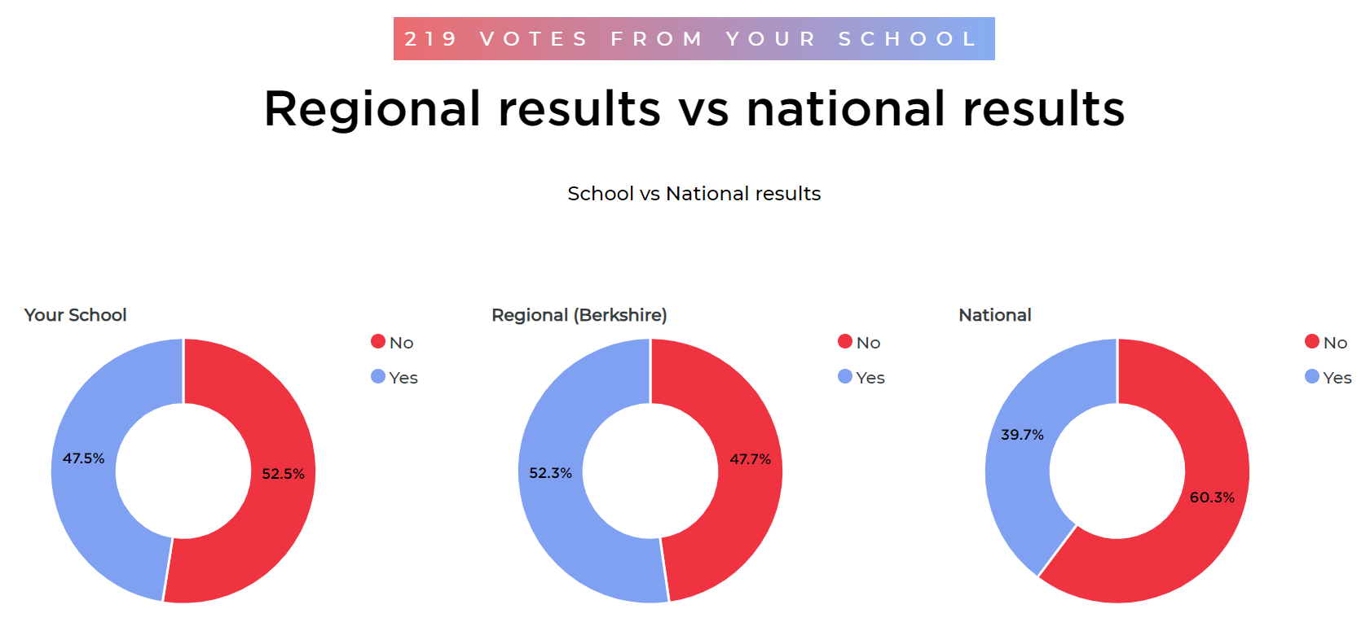
VFS champions

Slide 4


Your latest results: “Should the UK open new oil fields?”
VFS champions
“The opening of a new oil field in the North Sea by the UK Government is not in line with the Scottish Government climate goals. However, the plans to explore and use oil and gas from the UK is the decision of the UK Government. This means that the Scottish Government do not get to make the final decision. Changing to renewable energy is a big opportunity for Scotland and we want to make sure we are meeting our goals to tackle climate change. We hope we can do this in a way that makes
Scotland better.”
Click the image below to read the full letter.
Excerpt from a letter sent to VotesforSchools by Scottish Government (Riaghaltas na h-Alba)
Notes:
Quote has been paraphrased to make the letter more accessible to 7-11 year olds.
Full quote: “The recent licensing of a new oil fields in the North Sea by the UK Government is not in keeping with the Scottish Government climate goals. However, the policy on exploration and production of offshore oil and gas is the responsibility of the UK Government and so the Scottish Government does not have a say in the final decision. The Scottish Government sees great economic and energy potential of the renewable energy sector in Scotland. The Scottish Government is investing £500 million in a Just Transition fund for the North East and Moray supporting the regions journey to net zero. Also, the Scottish Government are providing support for the transition to renewable energy with the £75 million Energy Transition Fund which is supporting the protects existing jobs, skills and knowledge, and supports creation of new jobs in the North East, and across Scotland; as well as investing £100 million to the Green Jobs Fund which will help businesses to create new, green jobs in Scotland. The energy transition offers many opportunities for Scotland and it is key on delivering our emissions targets, but we must also make sure that it is a just transition that delivers for the people, communities and the economy of Scotland.”
Link to letter: https://voice.votesforschools.com/resource/access/a9f0a2aa-af38-41f4-b156-e29e842fcc0c/8995-edf2ae8a3389efcc9374
Images
Microsoft Office 365

Slide 5






Your views on “Should the UK open new oil fields?” were also heard by:
VFS champions
Greenpeace UK
North Sea Transition Authority
Equinor
Department for Energy Security & Net Zero
Just Stop Oil
Notes:
Images
https://www.greenpeace.org.uk/
https://twitter.com/NSTAuthority
https://commons.wikimedia.org/wiki/File:Equinor.svg
https://en.wikipedia.org/wiki/Department_for_Energy_Security_and_Net_Zero#/media/File:Department_for_Energy_Security_and_Net_Zero_Logo.svg
https://juststopoil.org/

Slide 6


Today’s VoteTopic:
VFS champions
Is it time to call
a general election?
UNCRC Article 15:
Setting up or joining groups
UN SDG 16:
Peace, justice & strong institutions
VfS Key Theme 4:
Global issues & politics
Notes:
Images
iStock

Slide 7
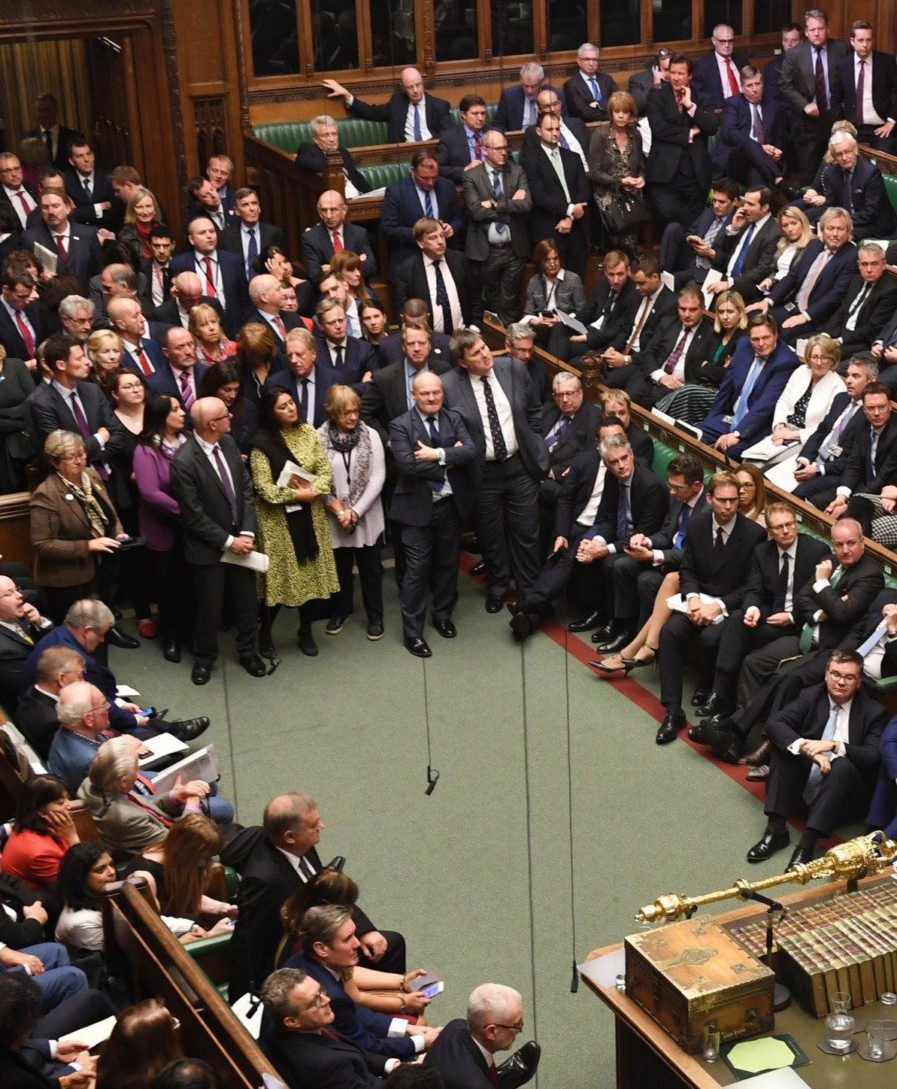
1
Why are we talking about this?
Teacher
Every five years, the UK holds a general election. Though a date hasn’t been set for the next one, it is due by January 2025.
General election:
When everyone aged 18 and over can vote for a group of people to be in charge of the country.
If people want to change who is in charge, the election can happen earlier.
Notes:
Images
https://upload.wikimedia.org/wikipedia/commons/8/83/House_of_Commons_debating_Brexit_deal_-_19_October_2019.jpg
References
https://www.bbc.co.uk/news/uk-politics-62064552

Slide 8
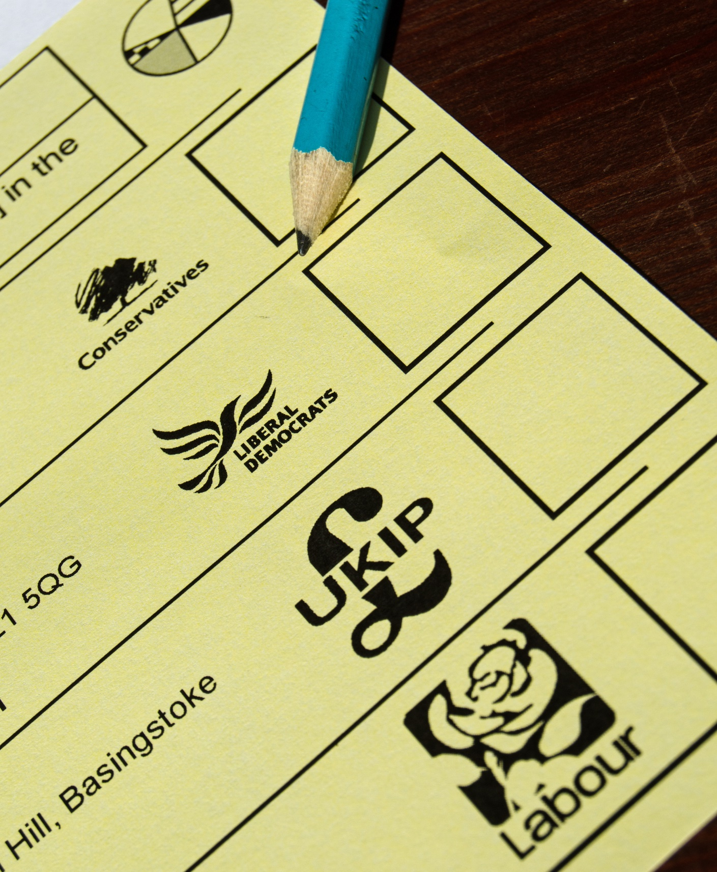
1
Why are we talking about this?
Teacher
An election gives people the chance to choose a new political party and leader to be in charge.
Political party:
A group of people who have the same ideas about what you should do when you are in charge.
This week, you will think about whether we should wait to have a general election or call one sooner.
Notes:
Images
iStock
References
https://dictionary.cambridge.org/dictionary/english/party

Slide 9
2
Yes, Pieminister
Teacher
Green Party
Democratic Unionist Party
Plaid Cymru
The Reclaim Party
Social Democratic & Labour Party
Alba
Party
Did you know?
All these political parties have had MPs in Parliament since the 2019 General Election. There are also MPs who are not members of a political party. They are called Independent MPs.
Pair discussion (1-2 mins)
Which political parties have you heard of? Make a list in your pairs. Then, click for answers. How many did you get?
Alliance Party
Liberal Democrats
Sinn Féin
Labour Party
Scottish National Party
Independent MPs
Conservative Party
Notes:
Images
https://upload.wikimedia.org/wikipedia/commons/8/83/House_of_Commons_debating_Brexit_deal_-_19_October_2019.jpg
References
https://www.bbc.co.uk/news/uk-politics-62064552

Slide 10
2
Yes, Pieminister
Teacher
Challenge (2-3 mins)
Can you match some of the other political parties to different parts of the
pie chart?
Whole class activity (1-2 mins)
This graph shows the current split of MPs in Parliament. Which political parties do the largest parts of the pie show?
Conservative Party
Democratic Unionist Party
Alliance Party
Scottish National Party
Liberal Democrats
Independent MPs
Alba Party
Plaid Cymru
Labour Party
Green Party
The Reclaim Party
Social Democratic & Labour Party
Sinn Féin
Notes:
Images
https://upload.wikimedia.org/wikipedia/commons/8/83/House_of_Commons_debating_Brexit_deal_-_19_October_2019.jpg
References
https://www.bbc.co.uk/news/uk-politics-62064552

Slide 11
2
Yes, Pieminister
Teacher
Independent MPs (14)
Democratic Unionist Party (8 MPs)
Liberal Democrats (15 MPs)
Sinn Féin (7 MPs)
Scottish National Party (43 MPs)
Plaid Cymru (3 MPs)
Conservative Party (353 MPs)
Labour Party (197 MPs)
Alba Party and Social Democratic & Labour Party each have 2 MPs.
Alliance Party, Green Party, and The Reclaim Party each have 1 MP.
Notes:
Images
https://upload.wikimedia.org/wikipedia/commons/8/83/House_of_Commons_debating_Brexit_deal_-_19_October_2019.jpg
References
https://www.bbc.co.uk/news/uk-politics-62064552

Slide 12
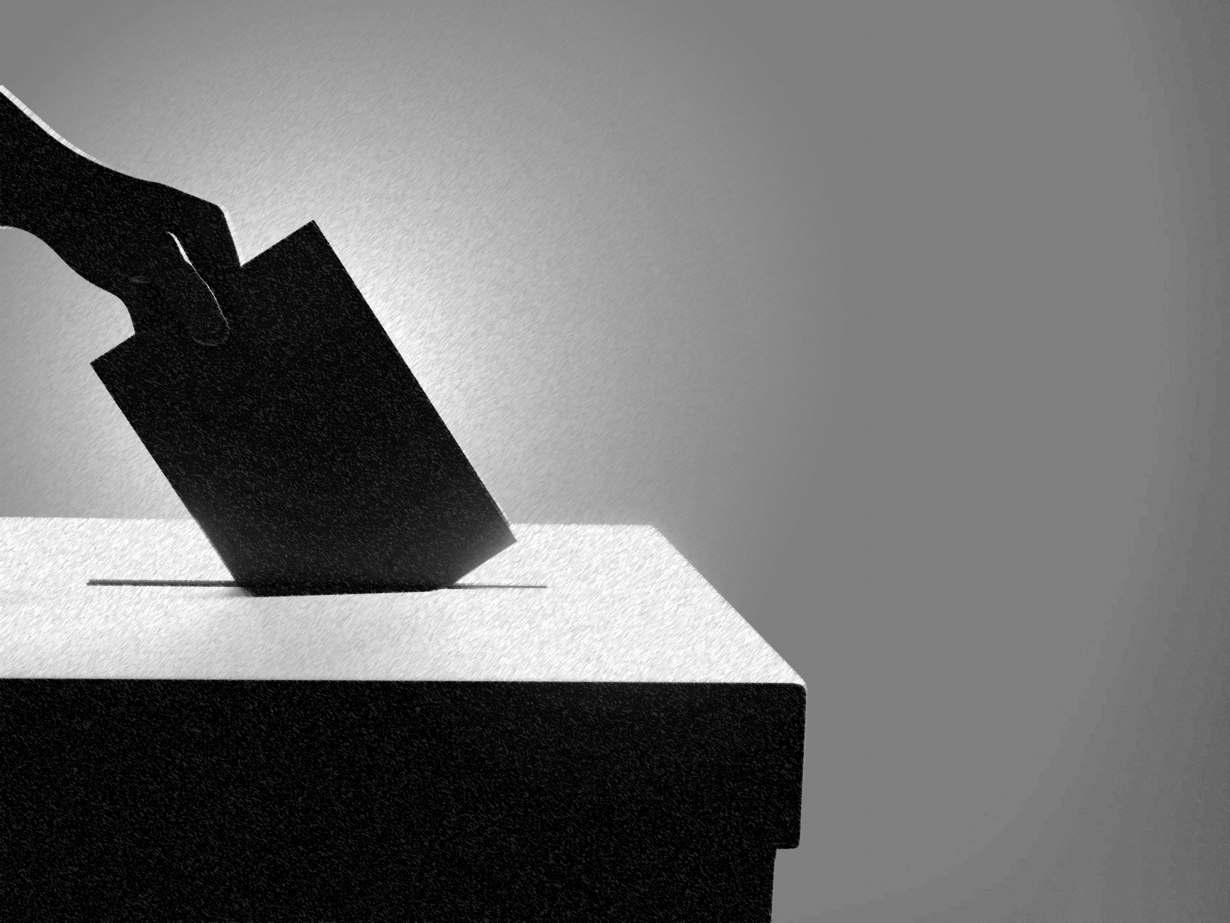
3
General knowledge
VFS champions
Whole class activity (5-10 mins)
Let’s look at some statements about general elections in the UK. For each one, fill in the gap with the correct answer. Show your answer by drawing a cross in the air when the option is read out.
Did you know? People put a cross next to the candidate they are voting for.
Notes:
Images
iStock
References
https://www.britannica.com/video/187554/types-voting-process-elections-United-Kingdom
https://www.britannica.com/video/187571/elections-United-Kingdom
https://www.bbc.co.uk/newsround/32206370

Slide 13
3
General knowledge
VFS champions
Candidates for different parties hope to become _______ for an area.
an MP
a Lord
a Dr
Member of Parliament:
A person who has been elected to help make decisions in parliament.
Notes:
Images
iStock
References
https://dictionary.cambridge.org/dictionary/learner-english/candidate
https://www.britannica.com/video/187554/types-voting-process-elections-United-Kingdom
https://www.britannica.com/video/187571/elections-United-Kingdom
https://www.bbc.co.uk/newsround/32206370

Slide 14
3
General knowledge
VFS champions
Before election day, candidates try to get people to _______
for them.
vote
stand
speak
Candidate:
A person who is trying to be elected.
Notes:
Images
iStock
References
https://dictionary.cambridge.org/dictionary/learner-english/candidate
https://www.britannica.com/video/187554/types-voting-process-elections-United-Kingdom
https://www.britannica.com/video/187571/elections-United-Kingdom
https://www.bbc.co.uk/newsround/32206370

Slide 15
3
General knowledge
VFS champions
People can vote on one day at a place called a _______ station.
dotting
polling
voting
Did you know?
There are other ways for people to vote if they are not able to go to the polling station.
Notes:
Images
iStock
References
https://www.britannica.com/video/187554/types-voting-process-elections-United-Kingdom
https://www.britannica.com/video/187571/elections-United-Kingdom
https://www.bbc.co.uk/newsround/32206370

Slide 16
3
General knowledge
VFS champions
The UK is divided into _______ constituencies.
450
650
850
Constituency:
An area of a country that elects someone to represent it in the Government.
Notes:
Images
iStock
References
https://dictionary.cambridge.org/dictionary/learner-english/constituency
https://www.britannica.com/video/187554/types-voting-process-elections-United-Kingdom
https://www.britannica.com/video/187571/elections-United-Kingdom
https://www.bbc.co.uk/newsround/32206370

Slide 17
3
General knowledge
VFS champions
The person with the _____ votes becomes the MP for that constituency.
most
least
same
Notes:
Images
iStock
References
https://dictionary.cambridge.org/dictionary/learner-english/constituency
https://www.britannica.com/video/187554/types-voting-process-elections-United-Kingdom
https://www.britannica.com/video/187571/elections-United-Kingdom
https://www.bbc.co.uk/newsround/32206370

Slide 18
3
General knowledge
VFS champions
To win a general election, a political party needs _____ people to
become MPs.
126
226
326
Did you know?
When there is no clear winner, this is called a hung parliament.
Notes:
Images
iStock
References
https://dictionary.cambridge.org/dictionary/learner-english/constituency
https://www.britannica.com/video/187554/types-voting-process-elections-United-Kingdom
https://www.britannica.com/video/187571/elections-United-Kingdom
https://www.bbc.co.uk/newsround/32206370

Slide 19
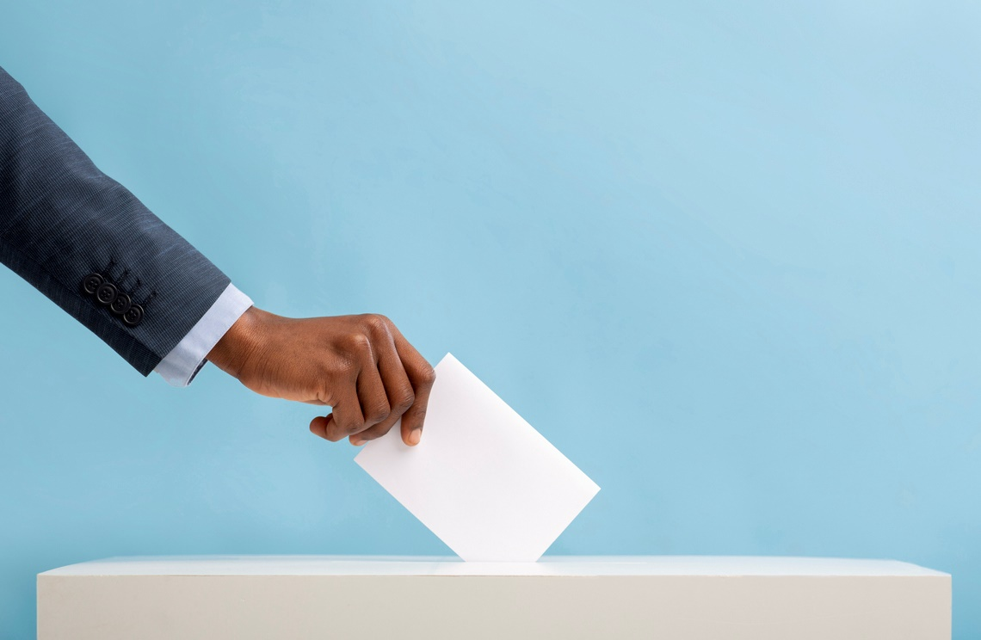


4
Time for change?
Teacher
Pair activity (5-10 mins)
Let’s look at some different problems facing the UK. For each one, decide whether you think a general election would help with this. If you think it would help, put your thumb up. If you think it wouldn’t help, put your thumb down.
Some people think that a change in leadership could help to solve problems facing the UK. Others feel that keeping the same political party in Government can help to lead the country through tricky times.
Would help!
Wouldn’t help!
Notes:
Images
iStock

Slide 20
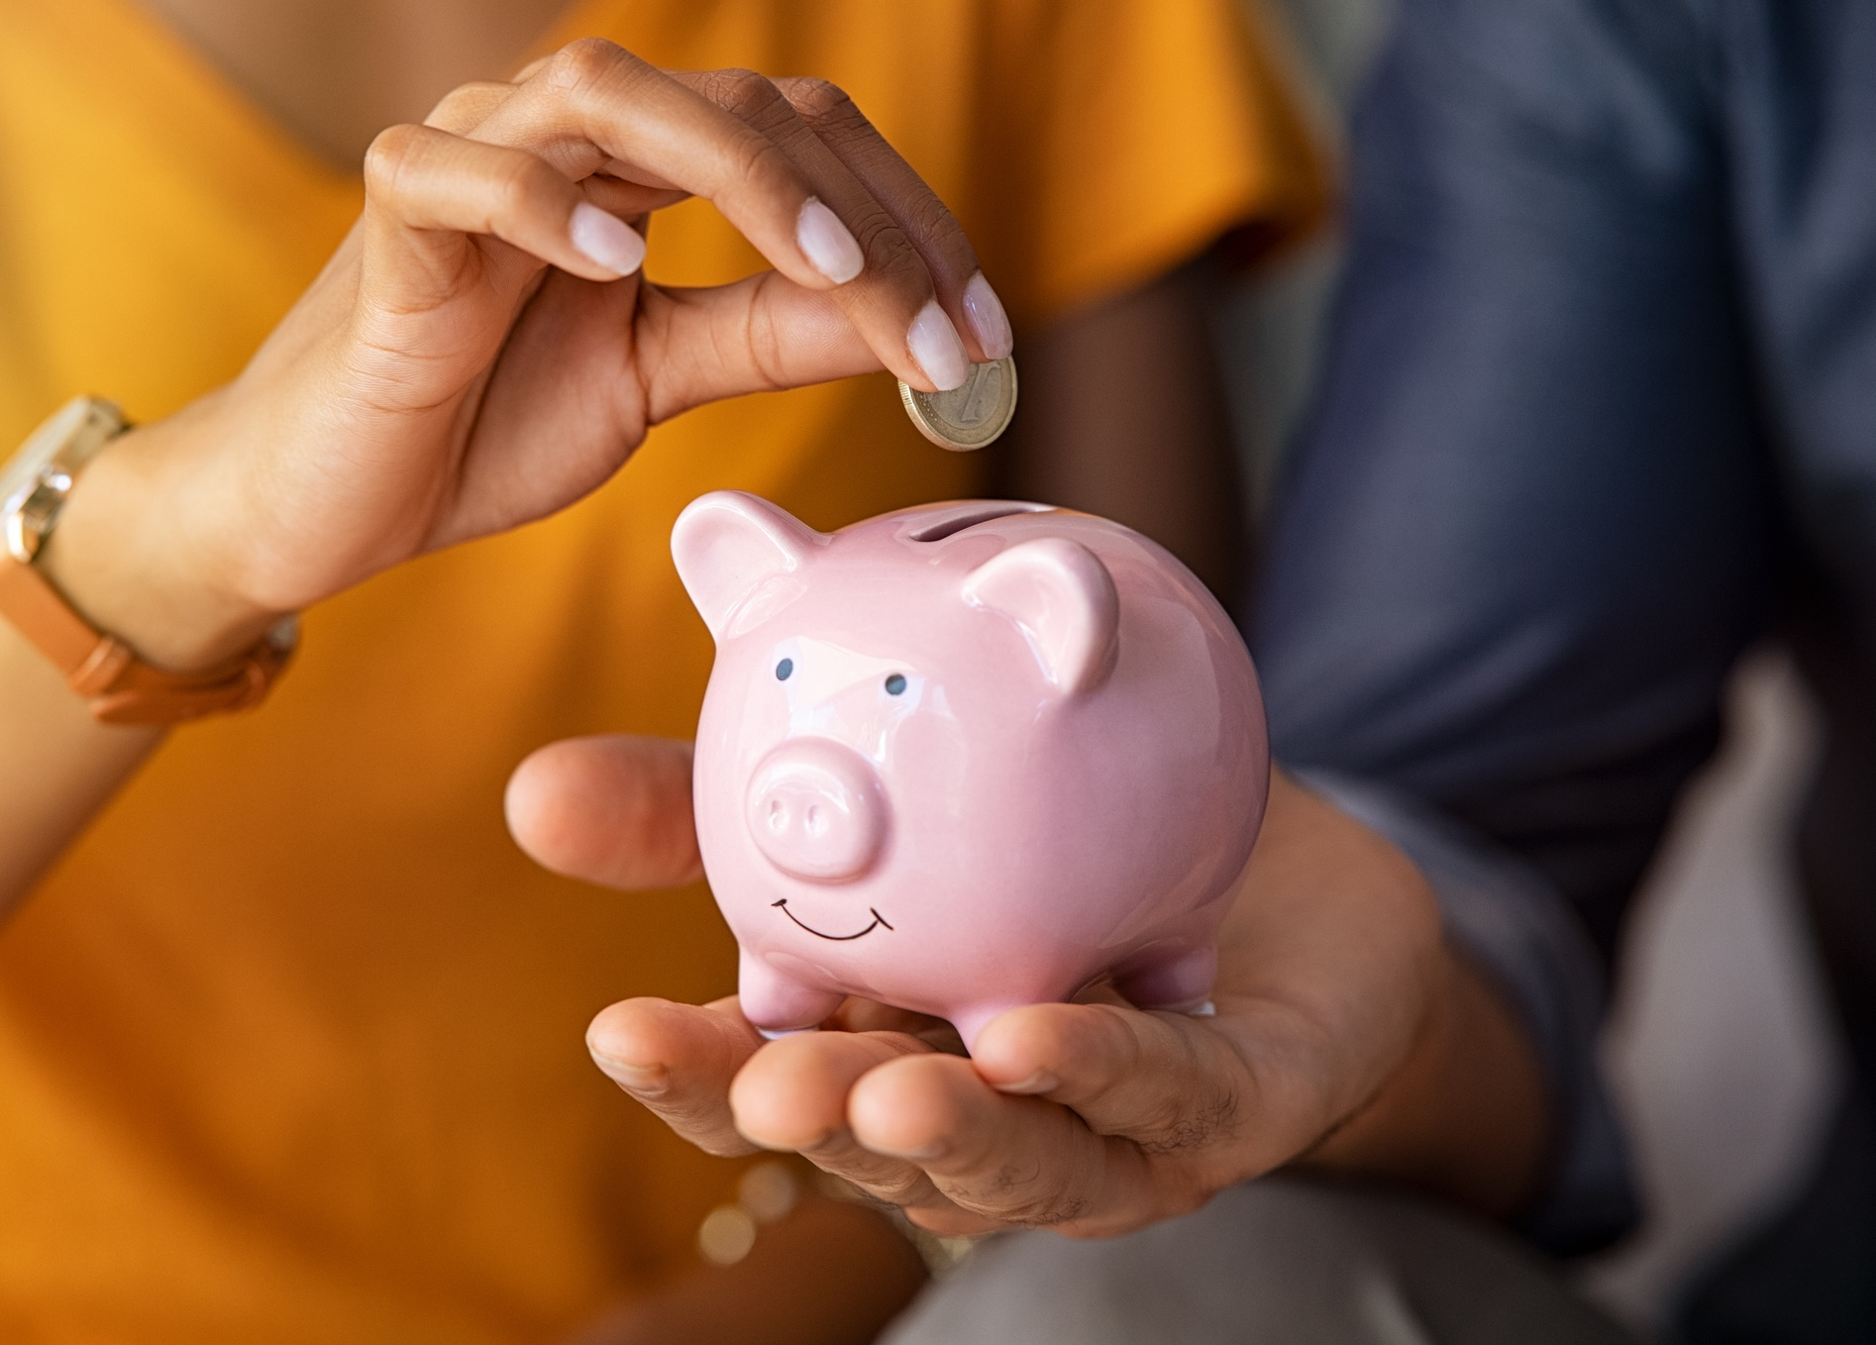
4
Time for change?
Teacher
Cost of living
Cost of living:
The amount of money that people have to spend on things that they need, like food, fuel and family life.
Notes:
Images
iStock
References
https://www.bbc.co.uk/newsround/62038311

Slide 21
4
Time for change?
Teacher
Recently, the cost of living has been more expensive in the UK and around the world.
The Government have said that they are trying to take action to make things easier, but people are still having to think about how to spend
their money.
Would help!
Wouldn’t help!
Would a general election help?
Notes:
Images
iStock
References
https://www.bbc.co.uk/newsround/62038311

Slide 22
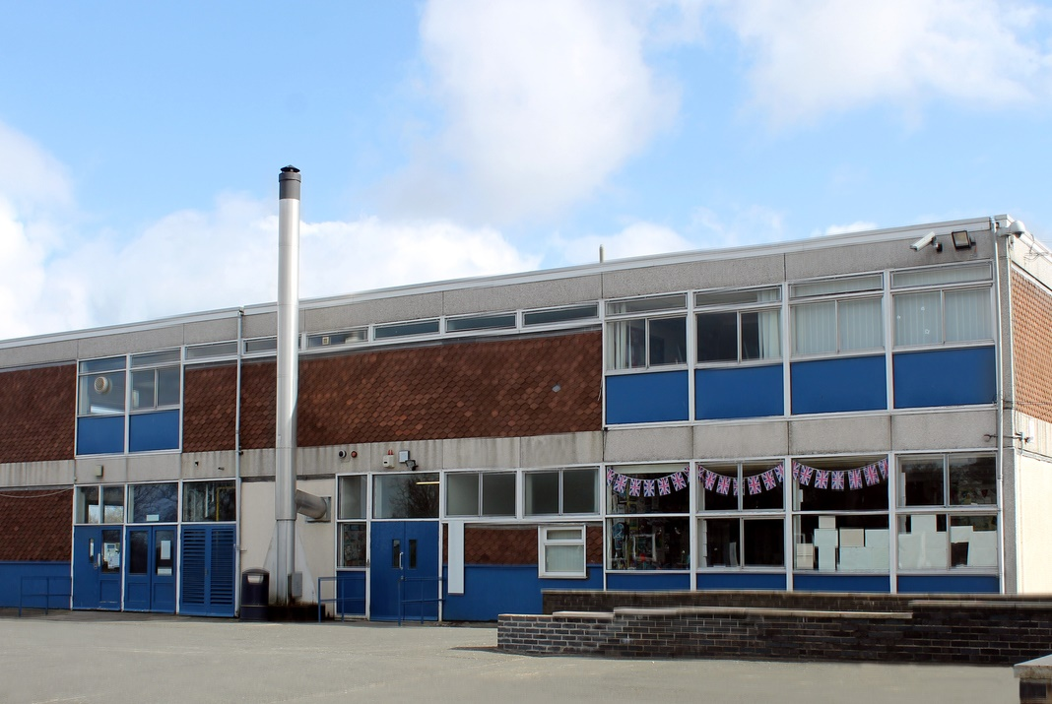
4
Time for change?
Teacher
Concrete in schools
Notes:
Images
iStock

Slide 23
4
Time for change?
Teacher
174 schools in England have been found to have a type of concrete (RAAC) that could be unsafe.
Any areas of buildings that have RAAC have been closed while they are fixed, so pupils are working in other classrooms, buildings
or from home.
Would help!
Wouldn’t help!
Would a general election help?
Notes:
Images
iStock
References
https://www.bbc.co.uk/newsround/66852665

Slide 24
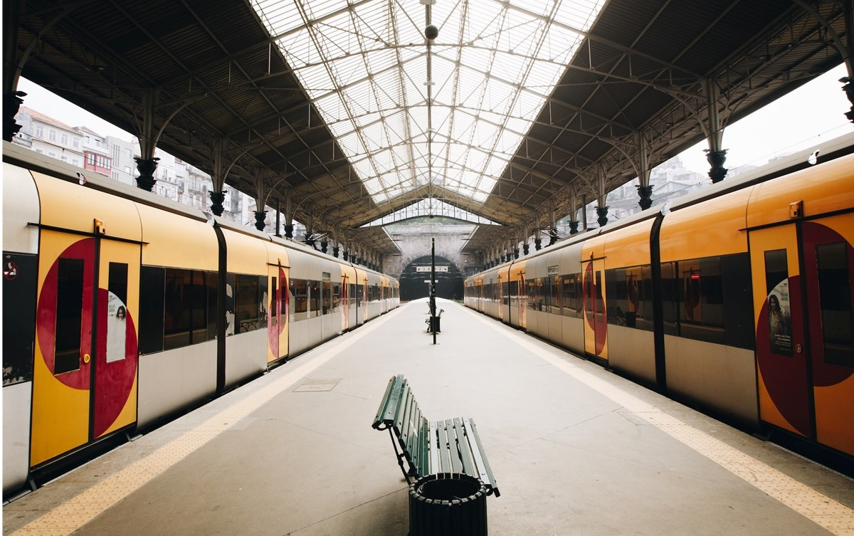
4
Time for change?
Teacher
Strikes
Strike:
When people stop working to show they are not happy with something. It is a type of protest.
Notes:
Images
Unsplash

Slide 25
4
Time for change?
Teacher
For over a year, strikes have been taking place across the UK.
People from across a range of jobs went on strike. Some of this ended in change, but more strikes are likely in the next few months.
Would help!
Wouldn’t help!
Would a general election help?
Notes:
Images
Unsplash
References
https://www.bbc.co.uk/newsround/61882043
https://dictionary.cambridge.org/dictionary/english/strikes

Slide 26

4
Time for change?
Teacher
Mental health
Mental health:
The way we think, feel and act.
Notes:
Images
iStock
References
https://www.mind.org.uk/information-support/for-children-and-young-people/understanding-mental-health/

Slide 27
4
Time for change?
Teacher
Making sure people have support to look after their mental health is important.
The Government has plans in place to help people’s mental health, but some people think they could do more.
Would help!
Wouldn’t help!
Would a general election help?
Notes:
Images
iStock
References
https://commonslibrary.parliament.uk/research-briefings/cbp-7547/
https://www.bedfordindependent.co.uk/letters-nspcc-calls-on-government-to-fund-mental-health-teams-in-schools/

Slide 28
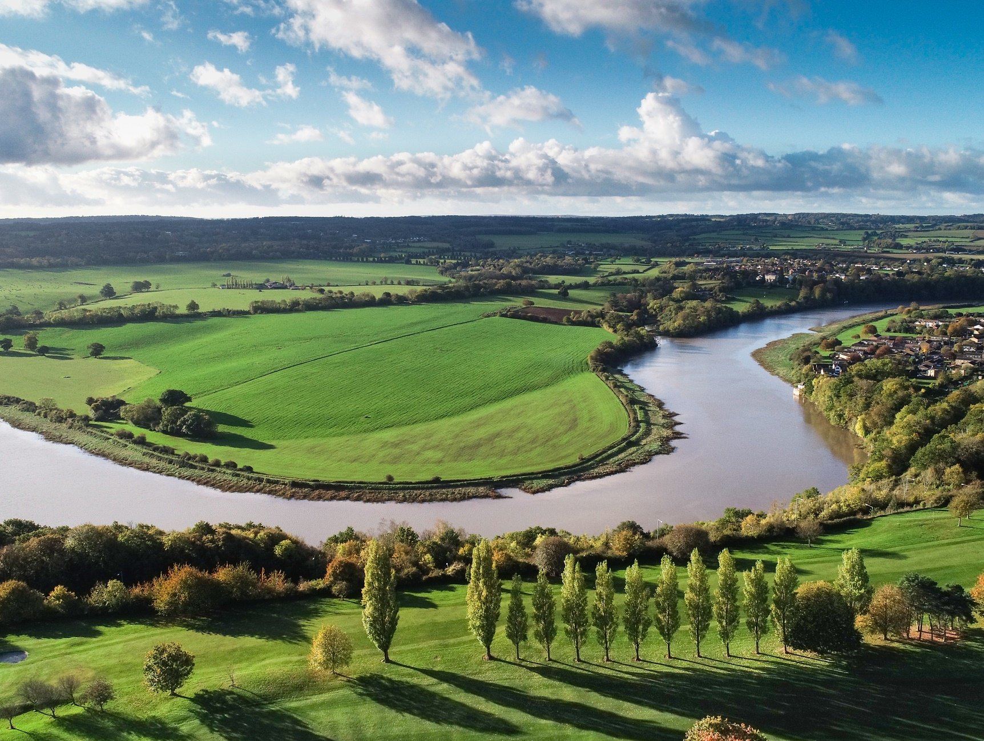
4
Time for change?
Teacher
Climate change
Curriculum link – Geography
What are some features of a river?
Notes:
Images
iStock

Slide 29
4
Time for change?
Teacher
Climate change is a big focus for Governments around the world.
Here in the UK, the Government have plans to tackle the climate crisis. However, some people think more action is needed.
Would help!
Wouldn’t help!
Would a general election help?
Notes:
Images
iStock
References
https://www.whatcar.com/news/petrol-diesel-car-ban/n23064
https://www.bbc.co.uk/news/uk-scotland-scotland-business-66933346

Slide 30
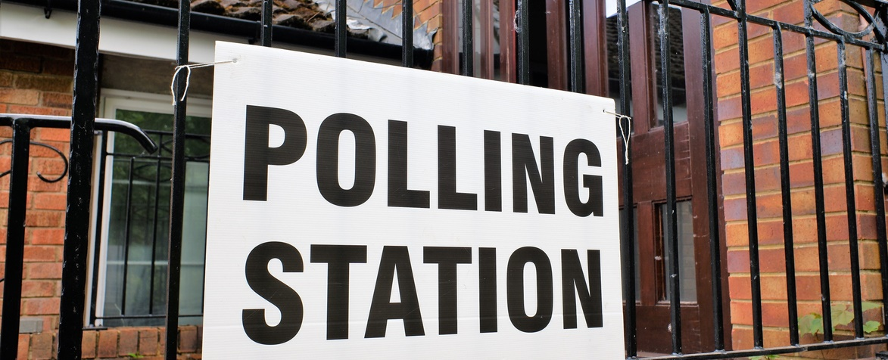
5
Now or later...
Teacher
Lots of the issues you have just seen will take some time to solve.
Some people think that we should wait until an election is due in January 2025, especially because we’ve had three Prime Ministers since the last general election. Others think we should call one as soon as possible.
Notes:
Images
iStock

Slide 31
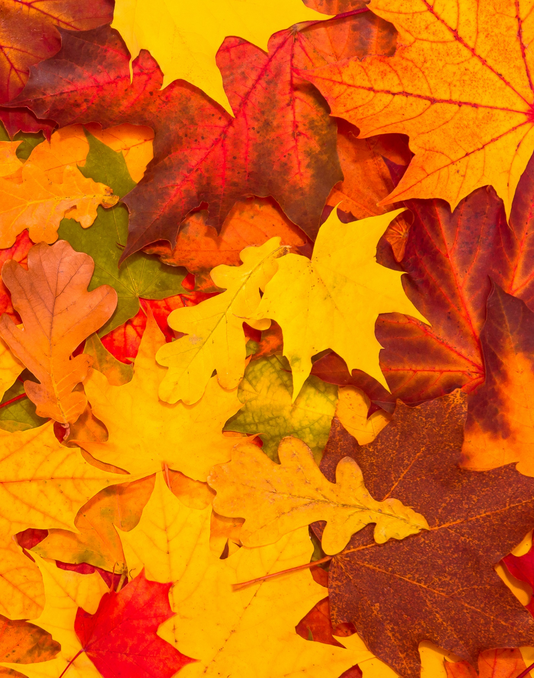

5
Now or later...
Teacher
Individual activity (1-2 mins)
When do you think a general election should be called? If you think a general election should be called as soon as possible, walk to the left. If you think a general election should wait until January 2025, walk to the right.
As soon as possible!
Wait until January 2025!
Notes:
Images
Microsoft Office 365

Slide 32
5
Now or later...
Teacher
As soon as possible!
Wait until January 2025!
I agree with your opinion because…
I share the same point of view because…
Whole class activity (5-10 mins)
Split into two groups. Half of the class will be in support of calling a general election as soon as possible, the other half will be in support of waiting until January 2025 for a general election. Debate it as a class. Use the sentence starters to help you.
I disagree with your opinion because…
I respect the point you have made. However, …
Notes:
Images
Microsoft Office 365

Slide 33
5
Now or later...
Teacher
Individual activity (1-2 mins)
Has your opinion changed? If you think a general election should be called as soon as possible, walk to the left. If you think a general election should wait until January 2025, walk to the right.
As soon as possible!
Wait until January 2025!
Notes:
Images
Microsoft Office 365

Slide 34
Now’s your chance to vote on: “Is it time to call a general election?”
VFS champions
Yes
I think an election should be called as soon as possible!
A general election might help to make change in the UK.
There have been three different Prime Ministers since the last election. A change is needed.
No, I think it’s best to wait until it’s due in January 2025!
A general election wouldn’t change much in the UK.
There have been three different Prime Ministers since the last election. We don’t need another change yet.
No
We will be sharing your thoughts on this topic with Parliament Week, The Politics Project, The Electoral Commission, British Youth Council, and The Local Government Association.
Log in to your VotesforSchools account to submit your vote and leave a comment.

Slide 35
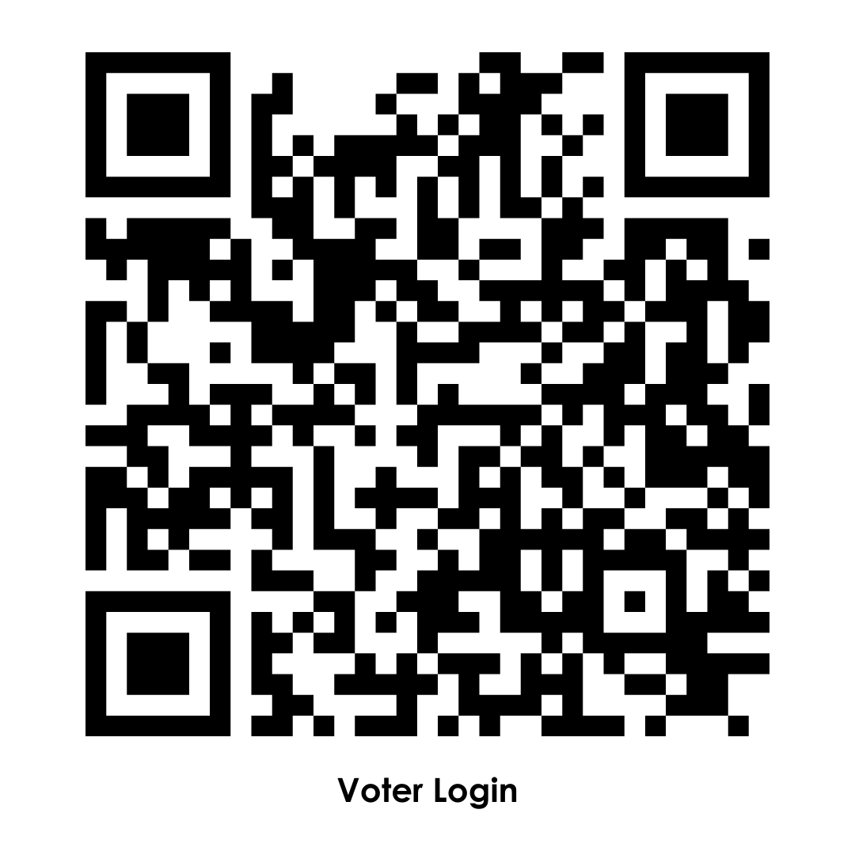
VFS champions
https://voice.votesforschools.com/

