Slide 1


R . Time
Autumn term
Lesson 1
CT - String a hollow tube (A5 paper rolled) between each pair.
Notes:
1

Slide 2
Rule
Show respect and good manners at all times
Follow instructions with thought and care
Care for everyone and everything

Slide 3
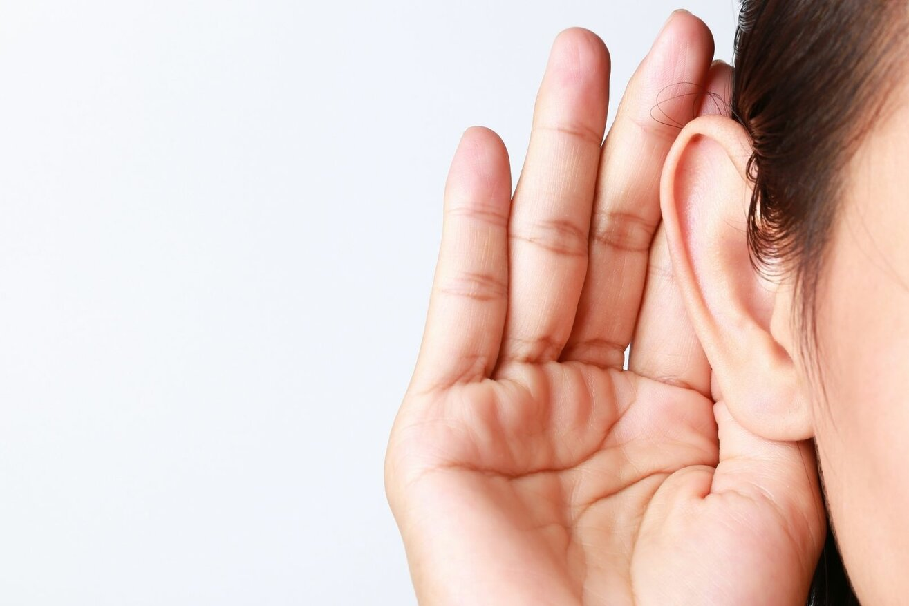
Instruction
We are going to listen to our partners carefully today.

Slide 4
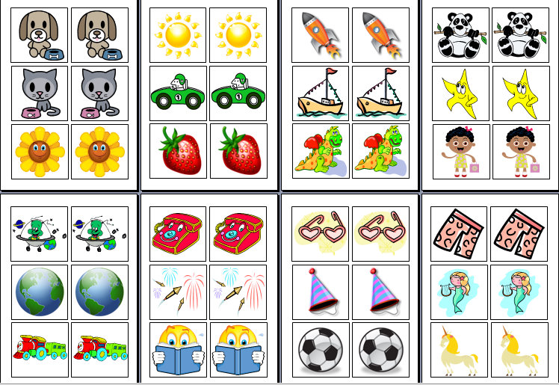
Random Pairing

Slide 6

Meeting and Greeting
Hello (partner’s name). Good to be your partner today.

Slide 7


Ice Breaker
If you could play a musical instrument which one would you choose to play?

Slide 8


The Activity
With your partner, thread the string through the tube. Discuss the best way to do it as a pair.
Is there anything different about the string?
(The string has made a journey through the tube.) We are making a journey through year 6.
What changes do you hope to see in yourself and the class as you move through the year?

Slide 9

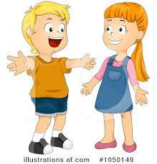
Plenary
Write some of the potential targets on paper and attach it to the end of the string.
Share some with the class.

Slide 10

Conclusion
I found your answers very interesting (partner’s name).

